Slide 1
Stock Analysis App
Aaron Downing and Ryerson Brower
Aaron.downing652@topper.wku.edu, Ryerson.brower178@topper.wku.edu

Slide 2
Introduction
Project Goal: Build an automated system that collects, stores, analyzes, and visualizes stock market data.
Motivation: Manual stock research is time-consuming and fragmented—this project centralizes price data, fundamentals, and analysis into one cohesive platform.
Core Idea: Combine real-time market movements with company financial data to generate deeper, data-driven insights.
Technology Stack: Python, MySQL, Docker, pandas, yfinance, and a React frontend

Slide 3
Project Overview
Real-Time Price Tracking: Continuously fetches stock prices and stores them in a MySQL database.
Fundamental Data Collection: Uses yfinance to gather key metrics for analysis.
Analysis & Visualization: Merges price and fundamental data to calculate technical indicators and generate insights.
Scalable Architecture: Each component runs in it’s own Docker container for easy deployment and isolation.
Frontend: React-based interface planned to display visualizations and analysis results

Slide 4
Functional Requirements
The project must be implemented using at least three distinct Docker containers: a Price Polling Service, a Fundamental Data Service, and an Analysis and Visualization Service.
The Price Polling Service must automatically fetch (generate/move) time-series price data (e.g., 5-minute intervals) for at least three different stock tickers from a public financial API (e.g., Alpha Vantage, Finnhub, or Yahoo Finance).
The Fundamental Data Service must automatically fetch (generate/move) company-specific financial metrics (e.g., P/E Ratio, Market Cap, or 52-week high) for the same stock tickers.
The Analysis and Visualization Service must consume data from the other two services, performing Data Fusion by linking the real-time price data with the fundamental data.
This service must perform Data Processing by calculating at least one technical indicator for each stock(e.g., a 20-period Simple Moving Average (SMA) or Relative Strength Index (RSI)).
The Analysis and Visualization Service must host a visual dashboard that allows a user to select a stock ticker and view its time-series price, the calculated technical indicator, and its fundamental metrics all on one screen.

Slide 5
Non-Functional Requirements
The entire 3-container application stack must be automated and launched using an Infrastructure as Code (IaC) tool, such as Docker Compose, for consistent orchestration.
The data schemas for all data in motion (price data, fundamental data) and the complete data pipeline must be clearly defined, visualized, and explained in the technical documentation.
The system must include robust error handling for API failures (e.g., rate limiting, invalid ticker, or network errors) and log these events without crashing any of the services.
The price data on the dashboard should be ”near real-time,” with data being no more than 15 minutes old.
The dashboard must be responsive, clear, and must load in under 10 seconds.
All communication between containers must be clearly defined (e.g., via REST API calls, a message queue, or a shared database volume).

Slide 6
Project Model
Modeling and Design
Service Separation
Design Principles
Database Design
Stocks -> Main DB
Price_data -> historical and real time prices
Fundamentals -> Company financials
Analysis_results ->Fused data with calculated indicators
Price Polling
Fetches live prices
Fundamental Data
Retrieves company fundamentals
Analysis & Visualization
Merges data & calculates insights
Frontend Service
Displays visualizations
Modular and containerized services for scalability
Clear separation of concerns
Easy to maintain and extend

Slide 7
Data Pipeline
Price Polling
Analysis & Visualization Service
React Web Dashboard
MySQL Database
Fundamental Data

Slide 8
Data Processing and Fusion
Price Data Processing
Fundamental Data Processing
1
Fetches live data
Cleans and validates data
Handles missing data
Converts timestamps
Stores processed data in DB
2
Collects company financial metrics
Cleans and standardizes fields
Stores in fundamentals data
Data Fusion & Analysis
Key Benefits of Fusion
3
Merges price_data and fundamentals based on stock symbol and data
Computes technical indicators
Generates analysis results stored in it’s own table
4
Combines price trends wiith company fundamentals for easier visualization
Enables advanced analysis
Prepares data for visualization in frontend

Slide 9
Model Implementation and Visualization
Implementation
Technical Indicator Calculations
RSI (Not displayed but is stored)
Moving averages (SMA)
Automation
Analysis service runs
Fusion based metrics
Modular Code Structure
Visualization
Matplotlib & Pandas-Based Charts
Price line chart with moving averages
Combined “Insights” chart
Frontend
React dashboard for interactive charts
Live data refresh
Filter by ticker
Purpose
Turn raw numbers into actionable insights
Easily identify trends

Slide 10
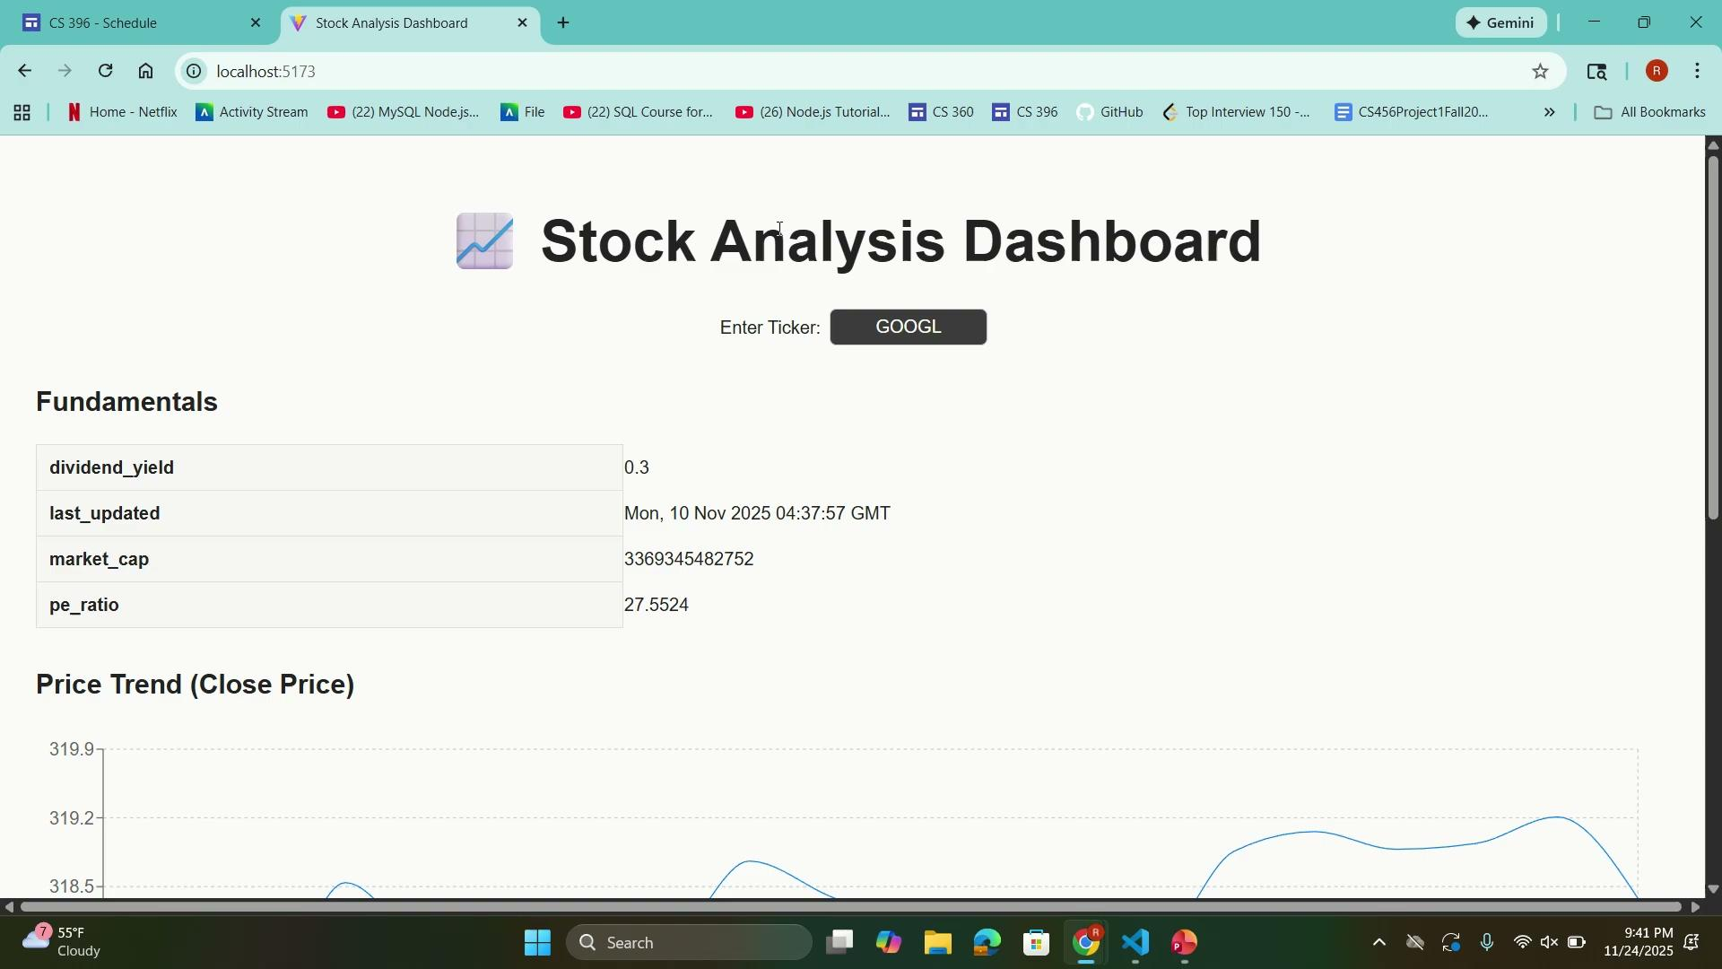

Slide 11
Conclusion
Integrated System: Successfully built a modular, containerized platform that collects price data, gathers fundamentals, performs analysis, and prepares visual insights.
Data-Driven Insights: Combined real-time market data with company fundamentals to generate meaningful technical indicators and trends.
Scalable Architecture: Service-oriented design using Docker enables easy maintenance, expansion, and future integration with a full frontend experience
Future Enhancements:
Additional technical indicators
Automated alerts and notifications
Machine learning–based forecasting
Overall Impact: Provides a foundation for a robust, automated stock analysis system that can be extended into a full research or trading tool.

Slide 12
Thank you

